Slide 1
Patching An Engine Control Module To Enhance Security
Spencer Beer
Jake Jepson
Aleksey Nogin, Ph.D.
Jeremy Daily, Ph.D.
DISTRIBUTION STATEMENT A.
Approved for public release; distribution is unlimited. OPSEC # 10915

Slide 2
Legacy systems can outlive their security assumptions
PLATFORM LIFECYCLE • DECADES
FIELDING
CAPABILITY UPGRADES
SUSTAINMENT
STILL OPERATING
SECURITY ENVIRONMENT • REPEATED SHORTER CYCLES
ORIGINAL TRUST
MODEL
NEW
CONNECTIVITY
NEW ATTACK
PATHS
NEXT THREAT
CYCLE
The platform can remain useful long after its original trust model expires.
Notes:
Defense and industrial platforms may remain mission-capable for decades while connectivity and threats change on a shorter cycle.
[Sources]
- Presenter-provided narrative framing for this workshop.
[/Sources]

Slide 3
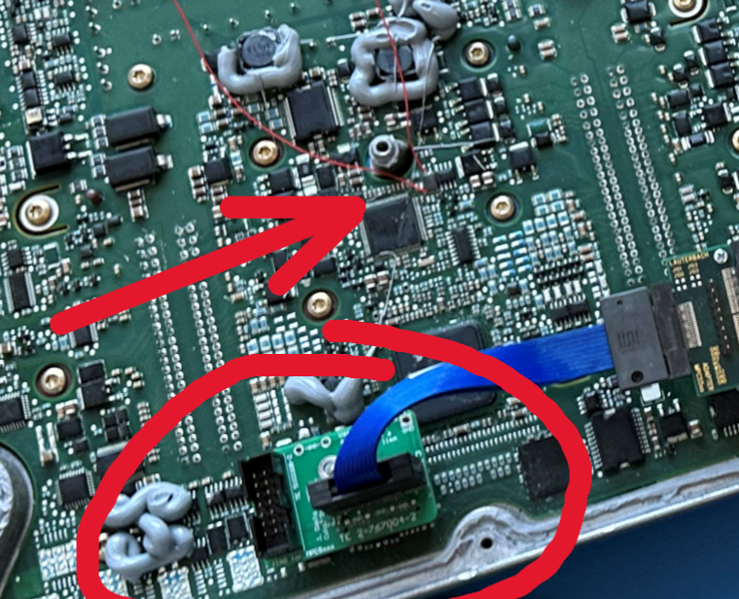
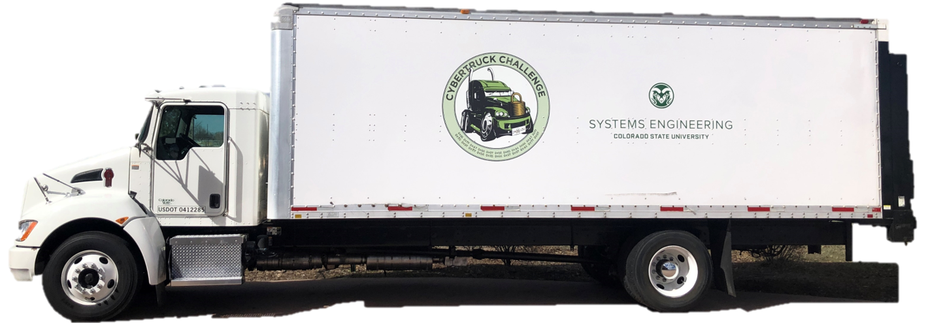

Legacy Platform Proof Point: 2014 Kenworth T270 ECM
2014 Kenworth T270
PACCAR/Cummins 6.7 L powertrain
NXP MPC5674F processor
Existing J1939 network
2014 - Networked Electronic Logging Devices (ELDs)
are rare. Not included in threat model.
2024 – Networked ELDs are common. Trucks often
used for 10-20 years. New threat, same platform.

Slide 4
An ECU is a dedicated computer that controls one vehicle function
SENSOR INPUTS
DECISIONS & OUTPUTS
PEDALS / SWITCHES
ECU
ACTUATOR COMMANDS
ELECTRONIC CONTROL UNIT
SENSOR VALUES
PROCESSOR
MEMORY
STATUS MESSAGES
FIRMWARE
THE SOFTWARE STORED INSIDE
MESSAGES FROM ECUs
FAULT CODES
A truck contains many ECUs: engine • brakes • transmission • telematics
ECM = the ECU responsible for engine control
Notes:
An electronic control unit, or ECU, is a small dedicated computer embedded in the vehicle. It reads sensor inputs, runs firmware, and commands physical outputs. A modern truck contains many ECUs with different responsibilities. The engine control module, or ECM, is the ECU responsible for controlling engine behavior.
[Sources]
- User-provided OPSEC-approved paper, system-of-interest and ECM architecture discussion.
[/Sources]

Slide 5
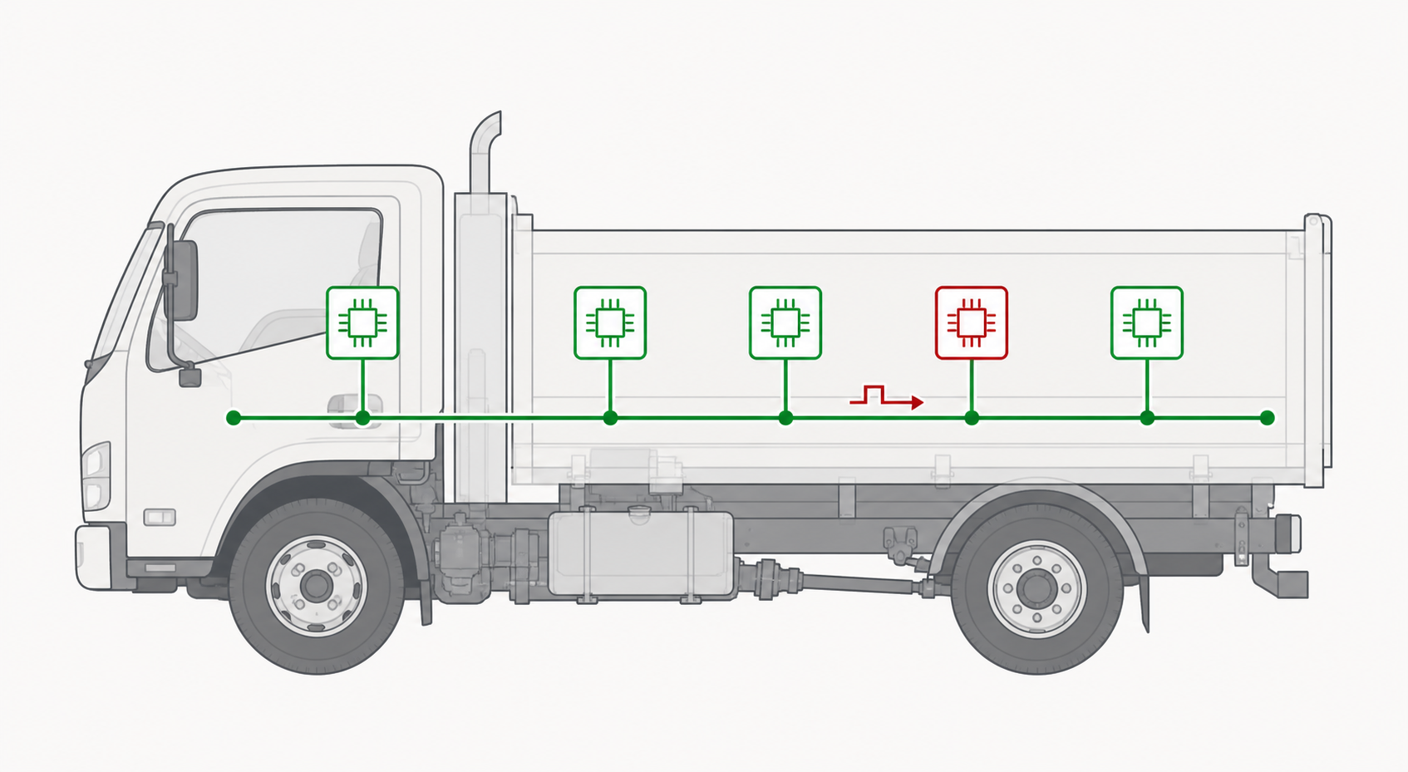
CAN broadcasts messages—but cannot authenticate senders
Controller Area Network
LEGITIMATE CONTROLLERS
COMPROMISED NODE
1
SHARED BUS
Every controller sees every message.
2
MESSAGE IDENTIFIER
Sets priority, meaning, and sender – Not cryptographically backed.
3
J1939
Standardizes message meaning on top of CAN.
A CAN FRAME, SIMPLIFIED
IDENTIFIER
DATA
UP TO 8 BYTES
CRC
IDENTIFIER ≠ IDENTITY
Receivers cannot tell which onboard node actually sent the frame.
Notes:
CAN is a shared broadcast bus. Arbitration uses the message identifier, while the CRC detects corruption in transit. Neither mechanism proves which controller originated a frame. J1939 defines message meaning on top of CAN but does not add sender authentication.
[Sources]
- User-provided OPSEC-approved paper, ‘Patching an Engine Control Module to Enhance Security.’
- OpenAI image generation, 2026-08-06. Generic truck/CAN trust-gap illustration; no logos or embedded text.
[/Sources]

Slide 6
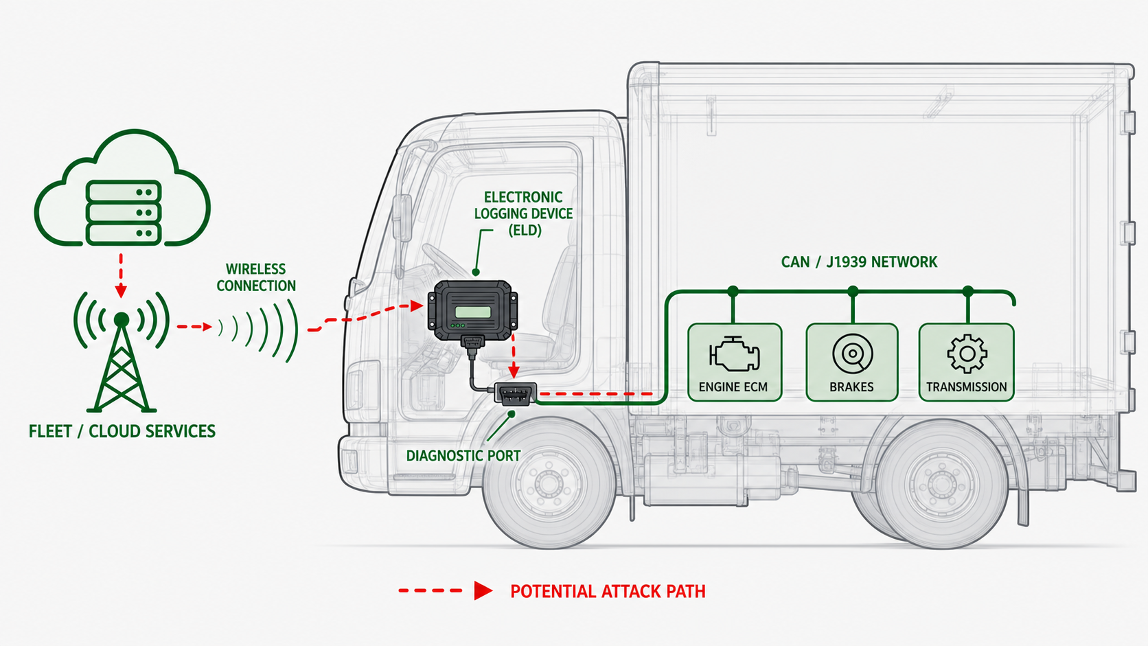
An ELD connects fleet operations to the vehicle network
Electronic Logging Devices
1
LEGALLY REQUIRED
For most commercial drivers since 2019.
2
LOGS HOURS & VEHCILE ACTIVITY
Commonly connects via the diagnostic port. Communicates directly with ECM for some required information.
3
WIRELESS CONNECTIVITY
Often includes wireless connectivity therefore bridging external networks to internal CAN network.
Notes:
CAN is a shared broadcast bus. Arbitration uses the message identifier, while the CRC detects corruption in transit. Neither mechanism proves which controller originated a frame. J1939 defines message meaning on top of CAN but does not add sender authentication.
[Sources]
- User-provided OPSEC-approved paper, ‘Patching an Engine Control Module to Enhance Security.’
- OpenAI image generation, 2026-08-06. Generic truck/CAN trust-gap illustration; no logos or embedded text.
[/Sources]

Slide 7
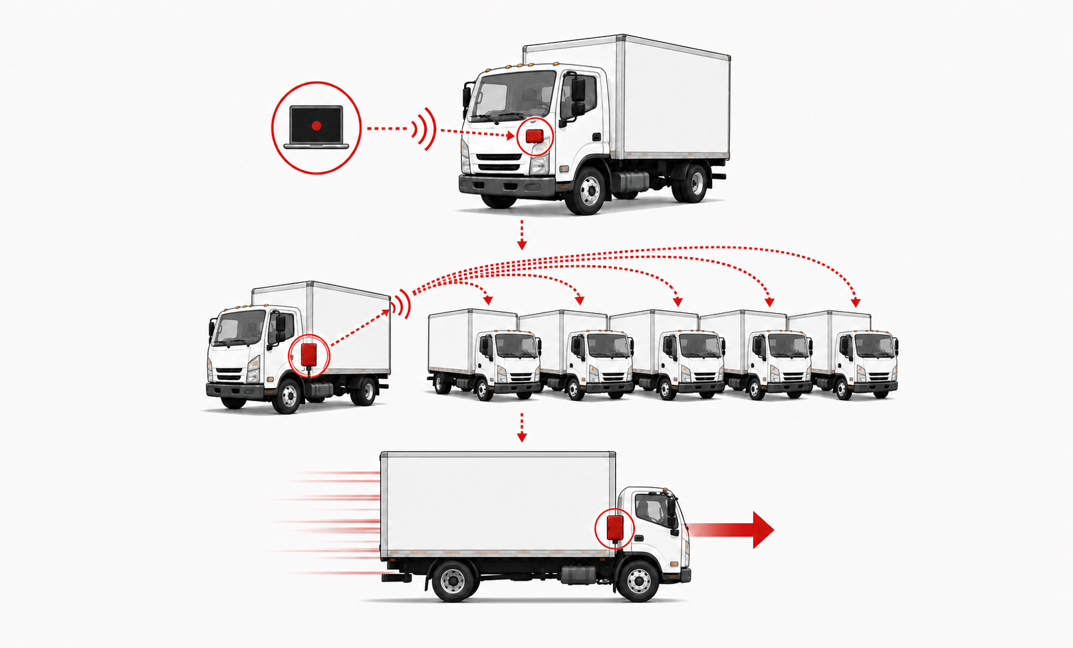
A 10–20-year platform can outlive its threat model
ELDs: RARE (2014) → COMMON (2024)
1
INFECT
A compromised laptop plants a self-propagating worm through an aftermarket ELD.
2
SPREAD
The infected truck carries it to nearby vehicles during normal fleet operations.
3
ATTACK
The worm waits for a chosen moment, then injects a malicious CAN command—such as maximum throttle.
Notes:
The ELD is an illustrative threat-model-drift example, not a claim from the paper. Explain the three stages from left to right: infect, spread, attack.
[Sources]
- Timeline and attack sequence synthesized from slides 3 and 7–9 of the supplied presentation.
- Right-side visual generated for this task from the user-approved three-stage sequence.

Slide 8
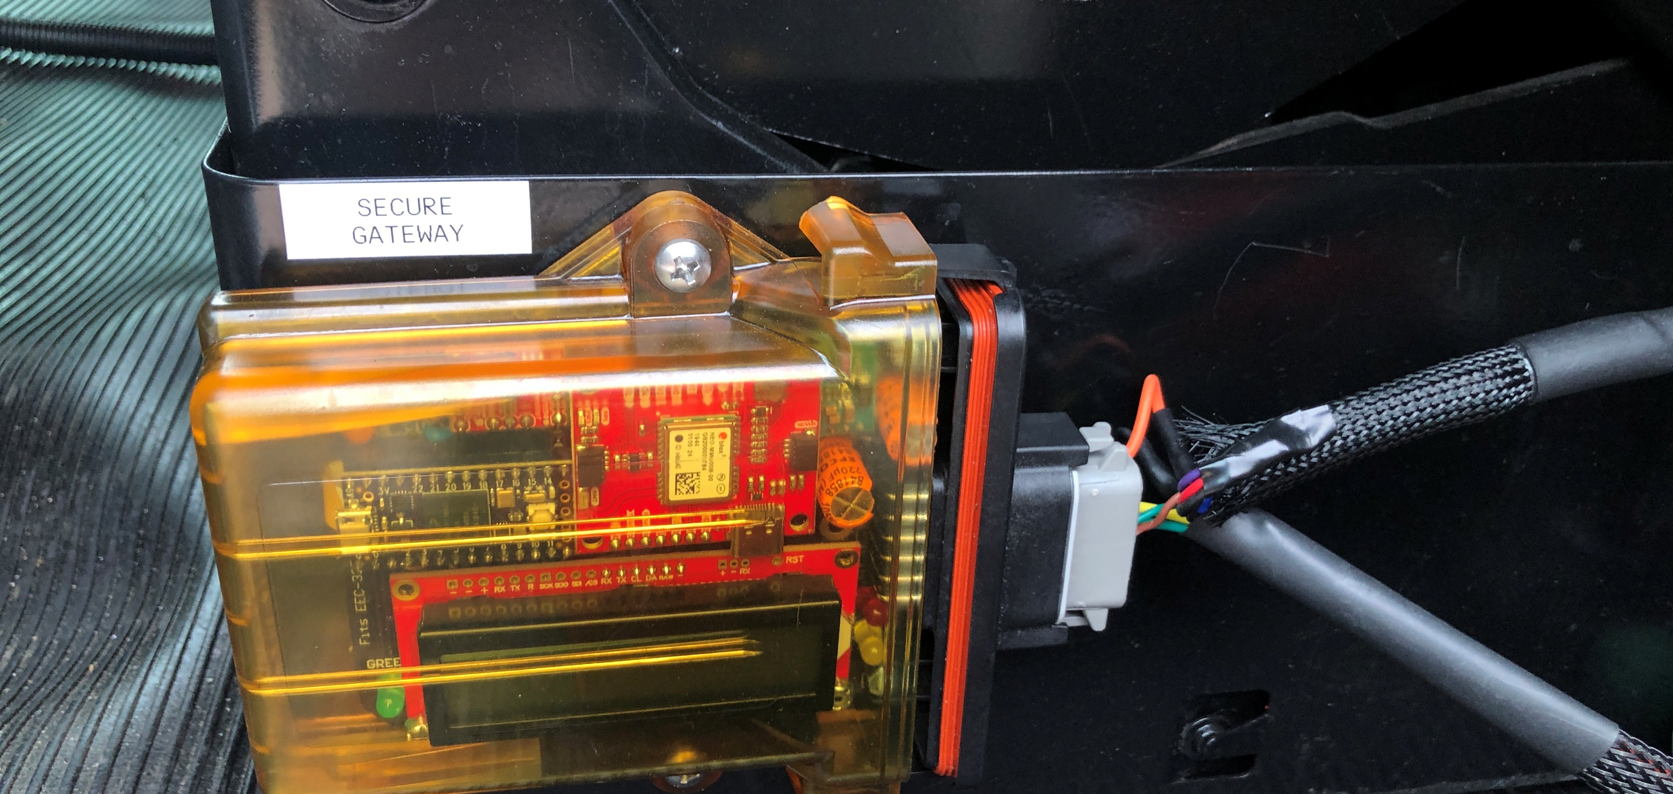
Previous work narrows the practical options
PROTOCOL AUTHENTICATION
ANOMALY DETECTION
EXTERNAL CAN CONDITIONER
THRESHOLD
ECU
AUTH
ECU
LEGIT
FALSE ALARM
PROTOCOL CHANGE
ATTACK
MISSED ATTACK
Ideal: authenticate every message at the protocol layer.
Infer attacks from timing or behavioral patterns.
Filter traffic and authenticate message history outside the ECM.
DEPLOYMENT TRADEOFF
DEPLOYMENT TRADEOFF
DEPLOYMENT TRADEOFF
BREAKS COMPATIBILITY—
UNLESS YOU OWN THE FULL STACK
TOO MANY FALSE ALARMS
OR MISSED ATTACKS
EXTRA HARDWARE + WIRING
INTEGRATION
The external CAN conditioner is the closest architectural starting point.
Notes:
Previous approaches improve security but create different deployment constraints. Protocol-level authentication is attractive but requires coordinated protocol and receiver changes. Anomaly detection is probabilistic and must trade false alarms against missed attacks. The prior external CAN conditioner is the closest architectural starting point because it combines deterministic filtering, cryptographic history, and an independent secure gateway—but it introduces a new hardware module.
[Sources]
- User-provided OPSEC-approved paper, Related Work discussion of machine-learning IDS, cryptographic approaches, and the external CAN conditioner.
- Existing conditioner image preserved from the user-provided presentation.
[/Sources]

Slide 9
Can we improve security without replacing the platform?
NO SOURCE
CODE
NO NEW SECURITY
HARDWARE
NO PROTOCOL
CHANGES
</>
J1939
The platform stays the same. The protection changes.
Notes:
The experiment is constrained to the deployed platform: no source code, no added security hardware, and no change to J1939. Hardware replacement may still be possible, but it adds integration, certification, downtime, and logistics cost.
[Sources]
- User-provided OPSEC-approved paper and presenter-provided narrative framing.
[/Sources]

Slide 10
CAN conditioners provide a working architecture
1 BLOCK KNOWN VIOLATIONS
Incoming frame
Source-address
filter
Accept or block
Enforces which source addresses may reach the patched ECM.
2 DETECT INJECTED FRAMES
Patched ECM
transmits
Update rolling
AES-CMAC
Periodic CMAC
report
The gateway independently builds the same history from observed bus traffic.
Filtering enforces policy. CMAC detects history divergence.
Notes:
The source-address filter and CMAC comparison solve different problems. Filtering blocks known policy violations; independent rolling histories expose injected or impersonated traffic that changes only the gateway's observation.
[Sources]
- User-provided OPSEC-approved paper and supplied presentation.
[/Sources]

Slide 11
Patching keeps the functions—but removes the inline box
PATCHED ECM
EXTERNAL CAN CONDITIONER
SAME
J1939 BUS
Original control logic remains in place
MOVE INTO
FIRMWARE
Source-address filter
Source-address
filter
Rolling
AES-CMAC
Rolling AES-CMAC
EXISTING GATEWAY
Independent CMAC
Security hooks injected into compiled firmware
Extra hardware + integration
Notes:
Micropatching retains the conditioner functions while eliminating the external inline device. The patched ECM performs filtering and CMAC generation. An existing gateway or ECU independently observes traffic and verifies the CMAC.
[Sources]
- User-provided OPSEC-approved paper and supplied presentation.
[/Sources]

Slide 12
Both sides process the same stream
PATCHED
ECM
Transmit
CAN frame
Update local
CMAC
Periodic DM18
CMAC report
MATCH
Continue
GATEWAY
Observe
bus frame
Update observed
CMAC
Do the CMACs
match?
DM1
intrusion alert
MISMATCH
An injected frame changes only the gateway's history—so the next report mismatches.
Ordinary J1939 application messages remain unchanged.
Notes:
The patched ECM and gateway process the same ordered stream. The ECM periodically sends its CMAC in DM18. The gateway compares that report with its independently maintained history. A match continues monitoring; a mismatch triggers a DM1 intrusion indication. An injected frame appears only in the gateway history.
[Sources]
- User-provided OPSEC-approved paper and supplied presentation.
[/Sources]

Slide 13
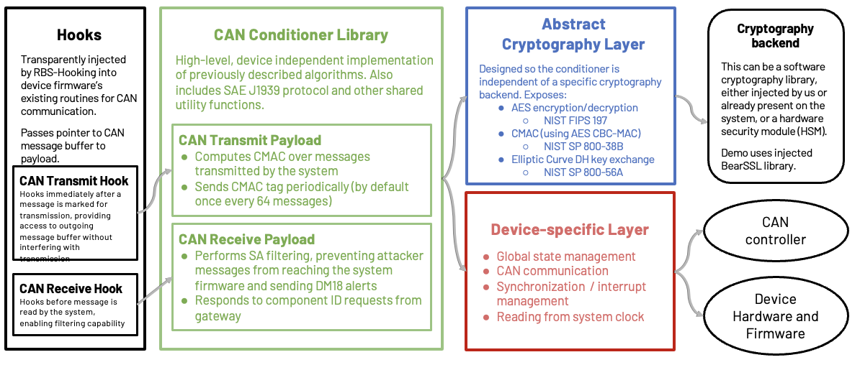
Modular Architecture
Notes:
The source-address filter belongs on the receive path before application logic processes untrusted frames. The rolling CMAC belongs on the transmit path after the ECM creates a frame but before the CAN controller sends it. This sets up the next slide's RX and TX handler hooks.
[Sources]
- User-provided OPSEC-approved paper and supplied presentation.
[/Sources]

Slide 14
A trampoline redirects execution to the patch—and back
INSERTED PATCH AREA
SECURITY
CODE
B + C
DISPLACED
INSTRUCTIONS
RETURN
JUMP OUT
JUMP BACK
ORIGINAL FIRMWARE LAYOUT
…
A
JUMP
D
E
F
…
The firmware stays in place; execution jumps out, runs the patch and displaced instructions, then returns.
Notes:
Locate code that first handles CAN messages, replace only enough instructions to insert a jump, run the inserted security code, execute the displaced instructions, and return to the original firmware path.
[Sources]
- Presenter-provided technical narrative.
- GVSETS paper: OFRAK/PatchMaker modification stage and function-hooking description.
[/Sources]

Slide 15
The patch must fit the ECM’s time, space, and state
TIME
SPACE
STATE
When can the patch run?
Where can the code live?
What must persist?
PROCESSOR WINDOW
FIRMWARE IMAGE
MESSAGE-TO-MESSAGE MEMORY
CONTROL
IDLE /
PATCH
CONTROL
ORIGINAL
FIRMWARE
PATCH
CODE
MESSAGE
n
CMAC + FILTER
MESSAGE
n+1
Profile the idle loop. Fit the CMAC work before the next control event.
Compile and link the patch into selected firmware regions.
Keep authentication history and filtering data available for the next message.
RECURRING IDLE WINDOW
CODE
PERSISTENT GLOBAL STATE
Notes:
The patch must satisfy three constraints at once. TIME is the recurring processor window available for the cryptographic work. SPACE is where PatchMaker places the compiled patch code and trampoline inside the firmware image. STATE is the CMAC history and filtering data that must persist across CAN messages; the implementation stores it in underutilized eTPU RAM.
[Sources]
- User-provided OPSEC-approved paper, OFRAK modification stage, processor profiling, and eTPU RAM discussion.
[/Sources]

Slide 16
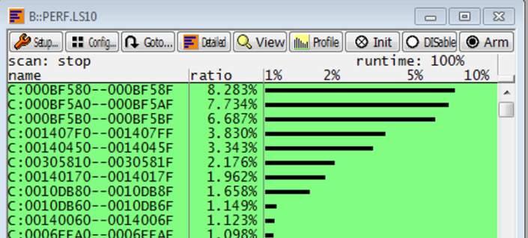
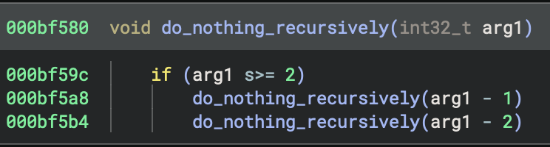
Profiling revealed processor headroom
22.7%
of samples landed in an idle-loop region
Headroom—not one continuous time window
Notes:
[Sources]
- 22.7% program-counter sample result and idle-loop interpretation from the user-provided OPSEC-approved paper.
[/Sources]

Slide 17
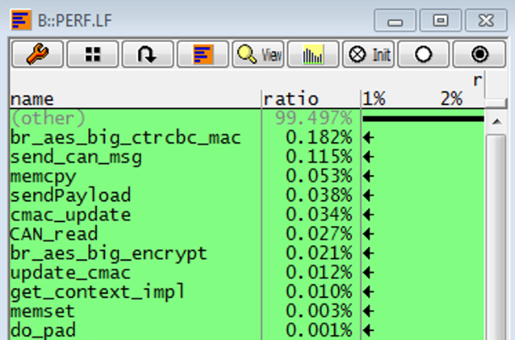
The CMAC workload fit inside that headroom
32 µs
average CMAC
0.5% CPU
250–500 µs per CAN frame
Notes:
[Sources]
- 32 microsecond average CMAC, 0.5% CPU utilization, and 250-500 microsecond CAN-frame reference from the user-provided OPSEC-approved paper.
[/Sources]

Slide 18
Underutilized memory provided the space for state
MPC5674F
Unused eTPU RAM held the patch state.
MAIN CPU
FLASH
GENERAL RAM
CAN CONTROLLERS
eTPU RAM
PATCH STATE
Notes:
[Sources]
- eTPU RAM selection and processor-peripheral context from the user-provided OPSEC-approved paper.
[/Sources]

Slide 19
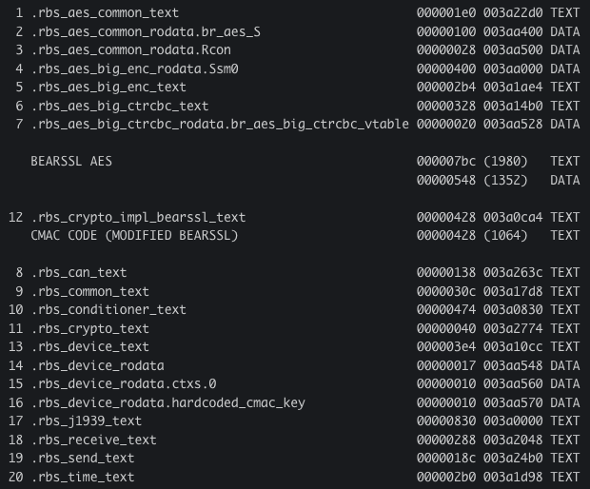
Plenty of room
Code added:
~2Kb for the cryptography library
~1Kb for CMAC operations
Data added (keys, tables, etc.):
~1.5Kb
Totaling: ~4.5Kb or approximately 1.17% of remaining free space.
Notes:
[Sources]
- eTPU RAM selection and processor-peripheral context from the user-provided OPSEC-approved paper.
[/Sources]

Slide 20
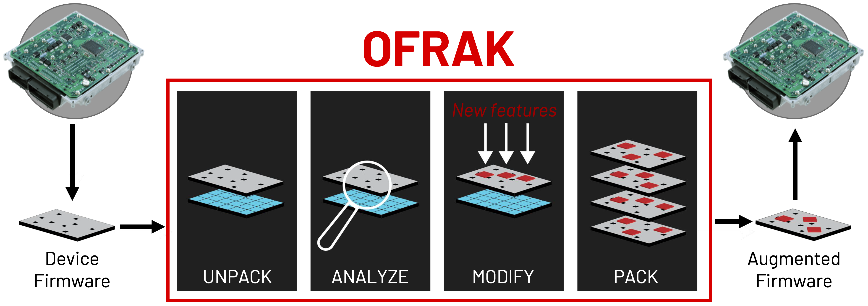
OFRAK makes the modification repeatable
UNPACK → ANALYZE → MODIFY → REPACK
Locate boundaries • Inject code • Recalculate validation • Produce a flashable image
Notes:
[Sources]
- OFRAK modification process summarized from the user-provided OPSEC-approved paper.
[/Sources]

Slide 21
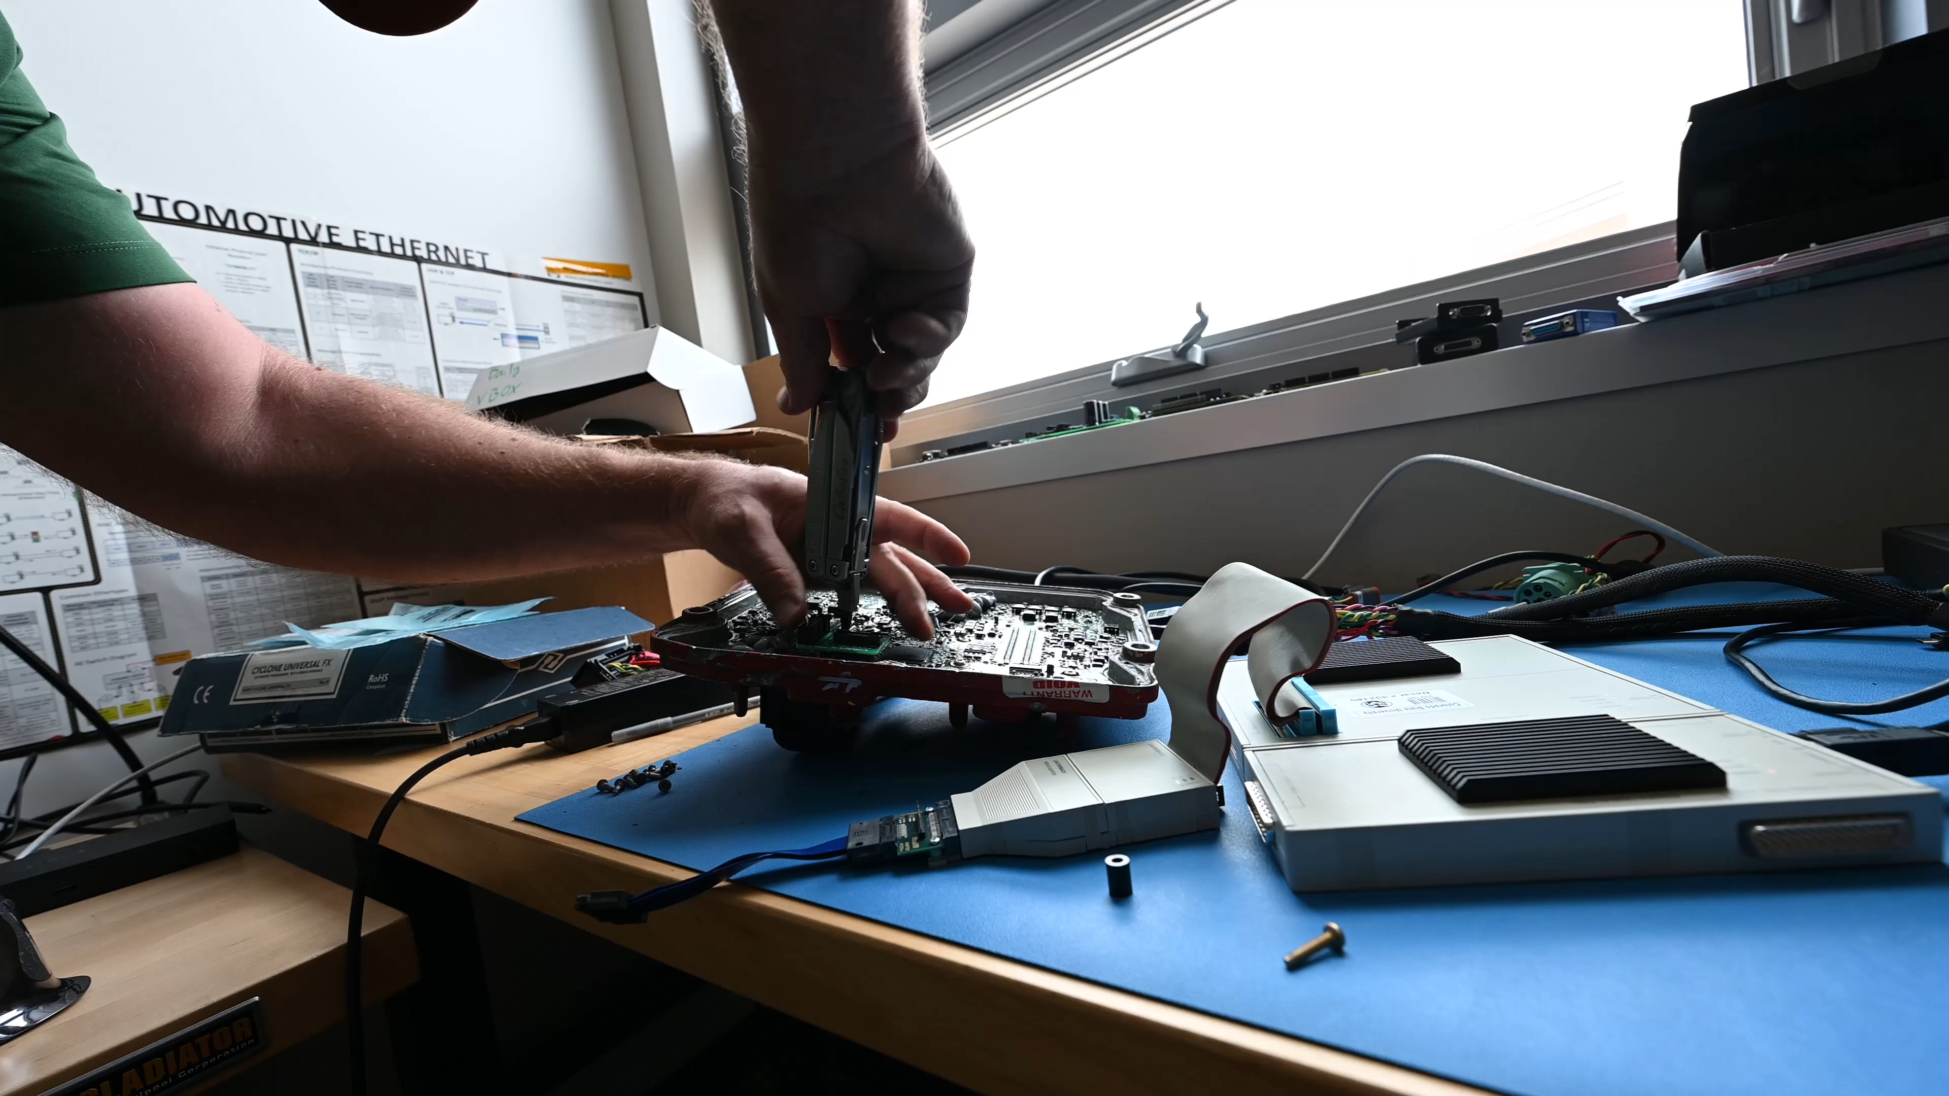
Modified firmware must still behave normally
Update validation → Flash spare ECM → Boot → Bench test

Slide 22
Validation must answer three questions
1
DOES IT DETECT SPOOFING?
Injected traffic must create a CMAC mismatch.
PATCHED ECM
2
DOES IT PRESERVE TIMING?
ORIGINAL CONTROL LOGIC
+ SECURITY PATCH
Normal message intervals must remain consistent.
3
DOES THE VEHICLE STILL OPERATE?
J1939 compatibility and drivability must remain intact.
Notes:
The validation section answers three questions in order: does the security mechanism detect spoofed traffic, does the added computation preserve message timing, and does the modified controller remain compatible and operational on the vehicle?
[Sources]
- User-provided OPSEC-approved paper, Functional Testing and final timing/vehicle tests.
[/Sources]

Slide 23
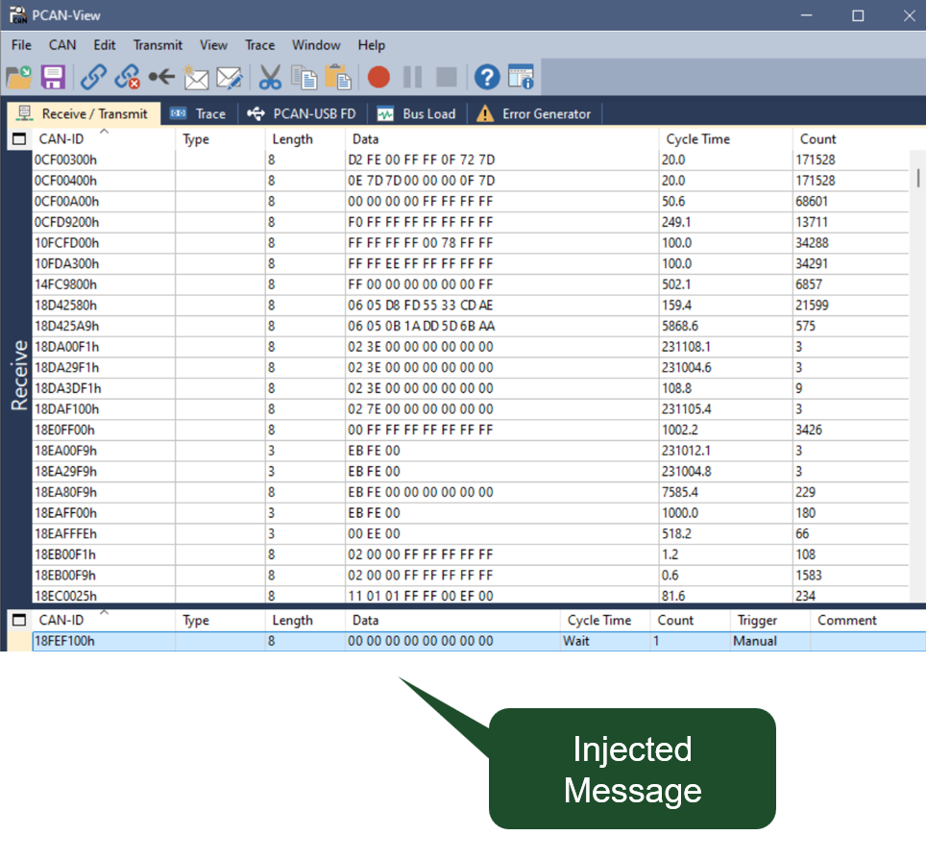
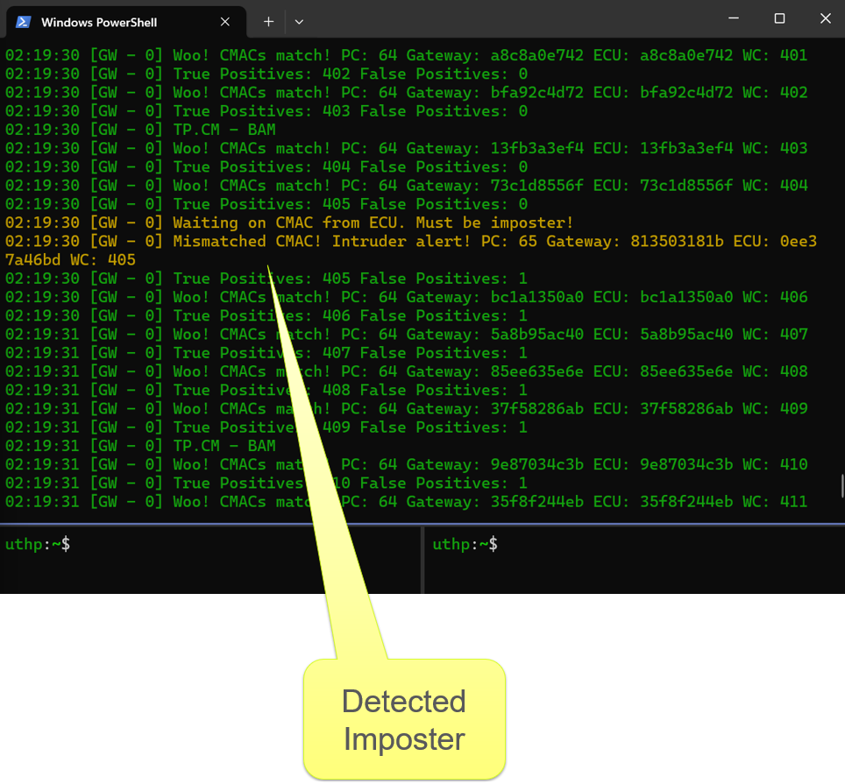
A spoofed frame produced a CMAC mismatch
1 INJECT A FRAME CLAIMING THE PROTECTED ADDRESS
2 GATEWAY REPORTS THE IMPERSONATION
Notes:
PCAN-View injects a frame using the protected ECM's source address. The gateway includes that frame in its observed message history, while the ECM does not include it in its locally transmitted history. The resulting CMAC mismatch produces the intrusion indication.
[Sources]
- User-provided OPSEC-approved paper, Functional Testing and Figures 5-6; original embedded figure assets.
[/Sources]

Slide 24
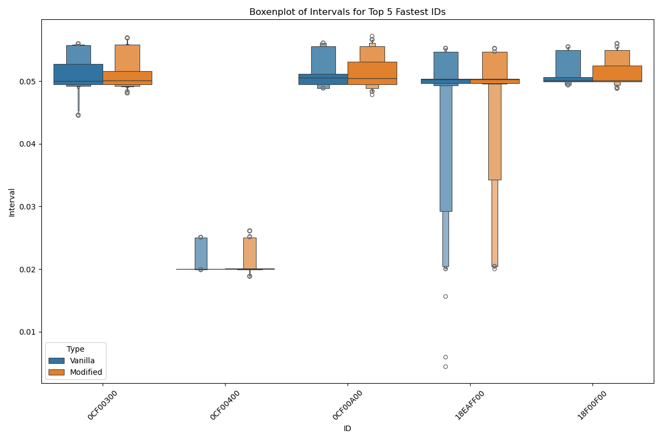
Final message timing remained consistent
NO NOTICEABLE INCREASE
in latency or bus load
Notes:
[Sources]
- Final timing and bus-load comparison from the user-provided OPSEC-approved paper.
[/Sources]

Slide 25

The patched ECM was installed on the truck
A spare ECM received the modified firmware.
The truck’s original controller remained untouched.

Slide 26
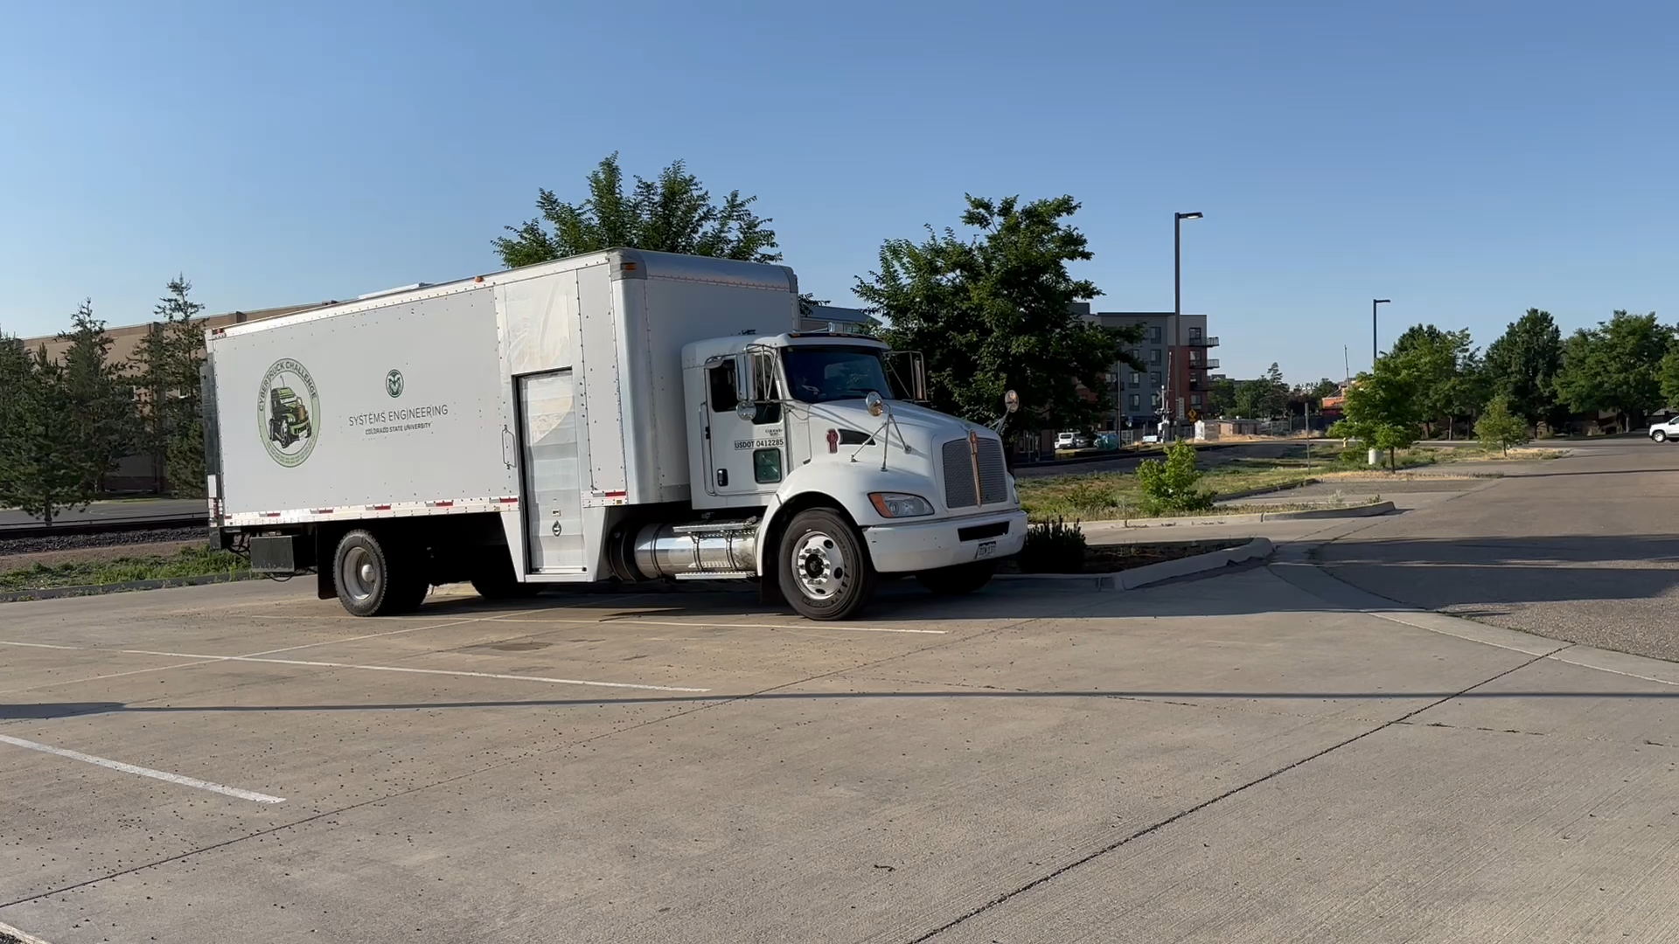
The truck remained drivable with CMAC active
CUSTOM FIRMWARE • CMAC ACTIVE • VEHICLE OPERATIONAL

Slide 27
The proof of concept met the original challenge
✓ PATCHED THE
BINARY
✓ USED EXISTING
CPU + eTPU RAM
✓ KEPT
J1939
Spoofing detected • Timing preserved • Truck drivable
Notes:
[Sources]
- Proof-of-concept constraints and results summarized from the user-provided OPSEC-approved paper.
[/Sources]

Slide 28
Future Work
Eliminate external gateway by integrating functionality into participating ECUs.
Utilize normal update system for patch deployment.
Strengthen key management and session-key establishment
Cover additional modules on the vehicle
Design intrusion detection across vehicle types and fleets with connected simulation systems

Slide 29
Conclusion
CMAC-based IDS successfully integrated into ECU
Spoofing was detected without meaningful latency, bus-load, or drivability impact.
The separate gateway and direct flashing process were scope choices—not technical requirements.
This establishes a practical path toward software-only security upgrades for legacy vehicles.
Acknowledgments
Supported by the Government under Contract No. W912CH-24-C-0008
Opinions, findings, and conclusions are the authors' and do not necessarily reflect the views of the corresponding government agencies

